Slide 1
Investigation
Of Network Traffic
Presented by
Shubham Singh (1NT18CS157)
V Venkata Sree Harsha (1NT18CS181)

Slide 2
Goal
To investigate packets flowing through the network to find any unencrypted image file being carried by any packet
To demonstrate hazards of transferring raw data(unencrypted)
header
payload(data)
packet

Slide 3
Tools Used
WireShark is a free and open source packet analyzer. It is mainly used for network trouble shooting, analysis, software & communication protocol development.
We are using it for analyzing the packets passing through the device

Slide 4
HxD editor
It is a hexadecimal editor software (also called binary editor, byte editor)
Hex editor: Allows computer file manipulation at the binary byte/bit level
We use it for generating the image file from the raw data that we receive from the packet

Slide 5
Problem Statement
We are provided with a ".pcap" file containing snapshot of the network traffic
The task is to extract raw image files (if any) being carried by the packets

Slide 6
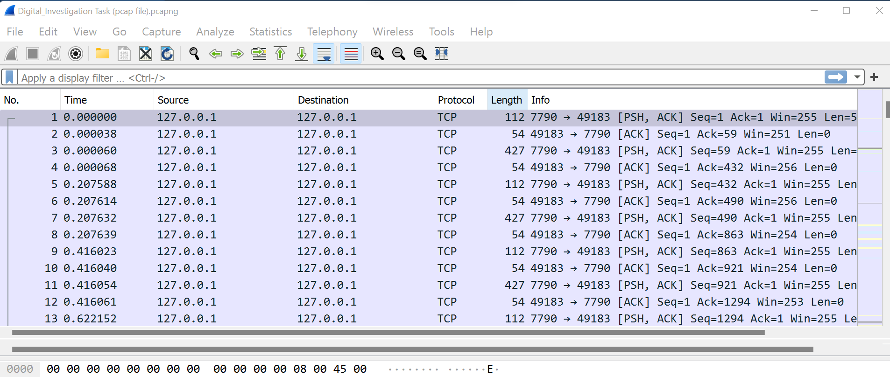
Steps to follow
Open the packet capture file using the wireshark tool
All the packets with relevant information (timestamp, protocol, data being carried etc.) will be displayed

Slide 7
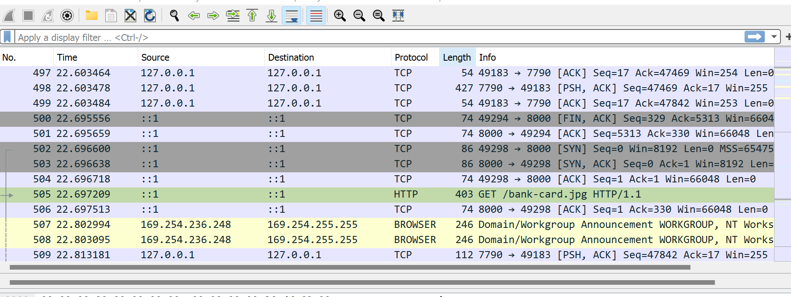
Look for any possible image extensions (such as jpg, png, gif etc) in the packet's information field from the list of packets
Image data

Slide 8
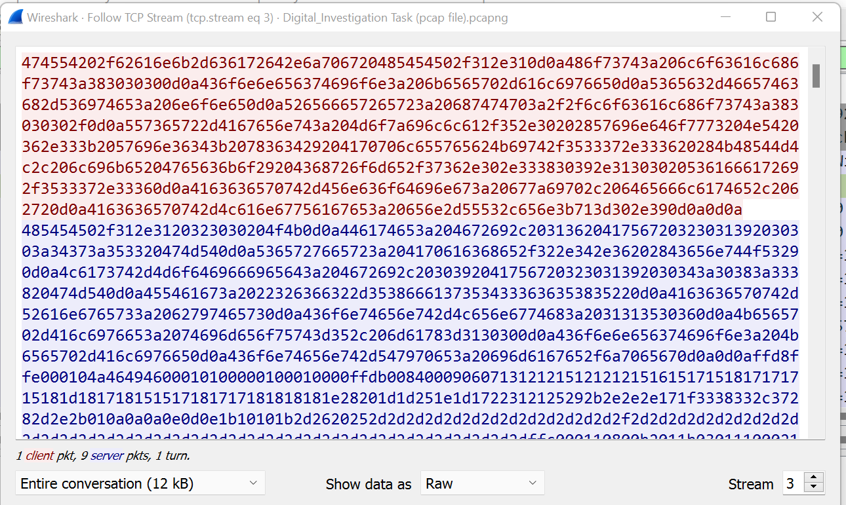
Select the packet containing the image data and expand it to view its raw binary dump

Slide 9
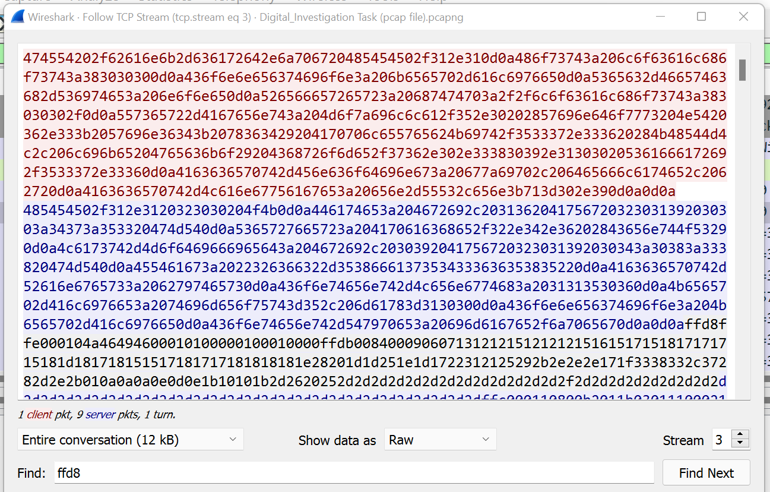
Search and select the sequence from ffd8 to ffd9. This will be the binary data corresponding to the image file
start

Slide 10
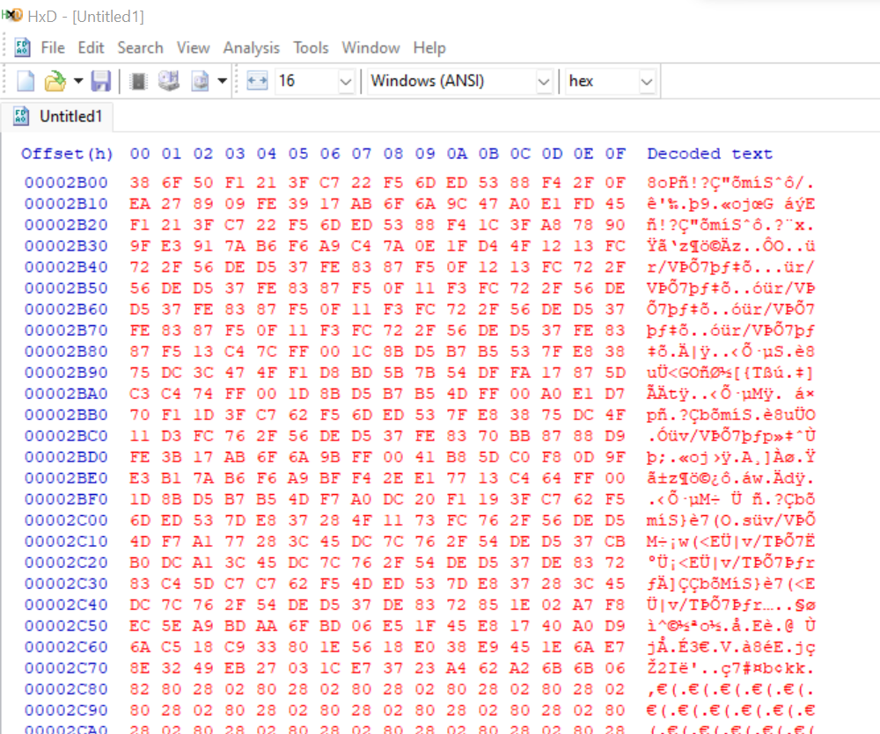
Paste the binary data in a new file in HxD editor. Save the file with the extension that was mentioned in wireshark.

Slide 11
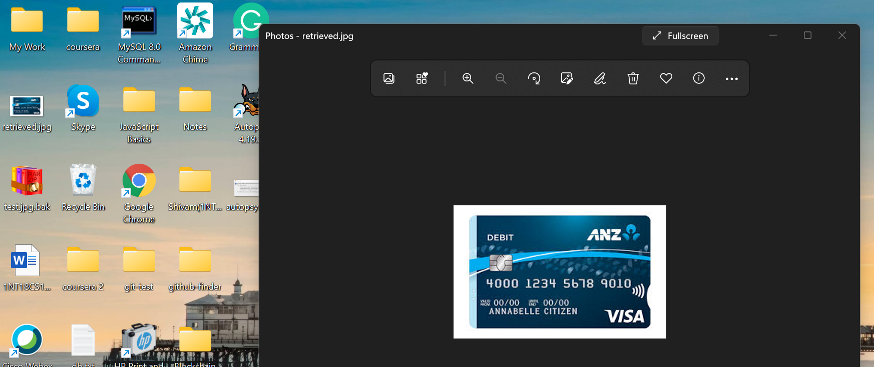
The corresponding file is generated in the specified location

Slide 12
Conclusion
It is very easy to get hold of raw data being transferred through man in the middle attack
Data should always be encrypted before transferring

Slide 13
THANK YOU

